Slide 1
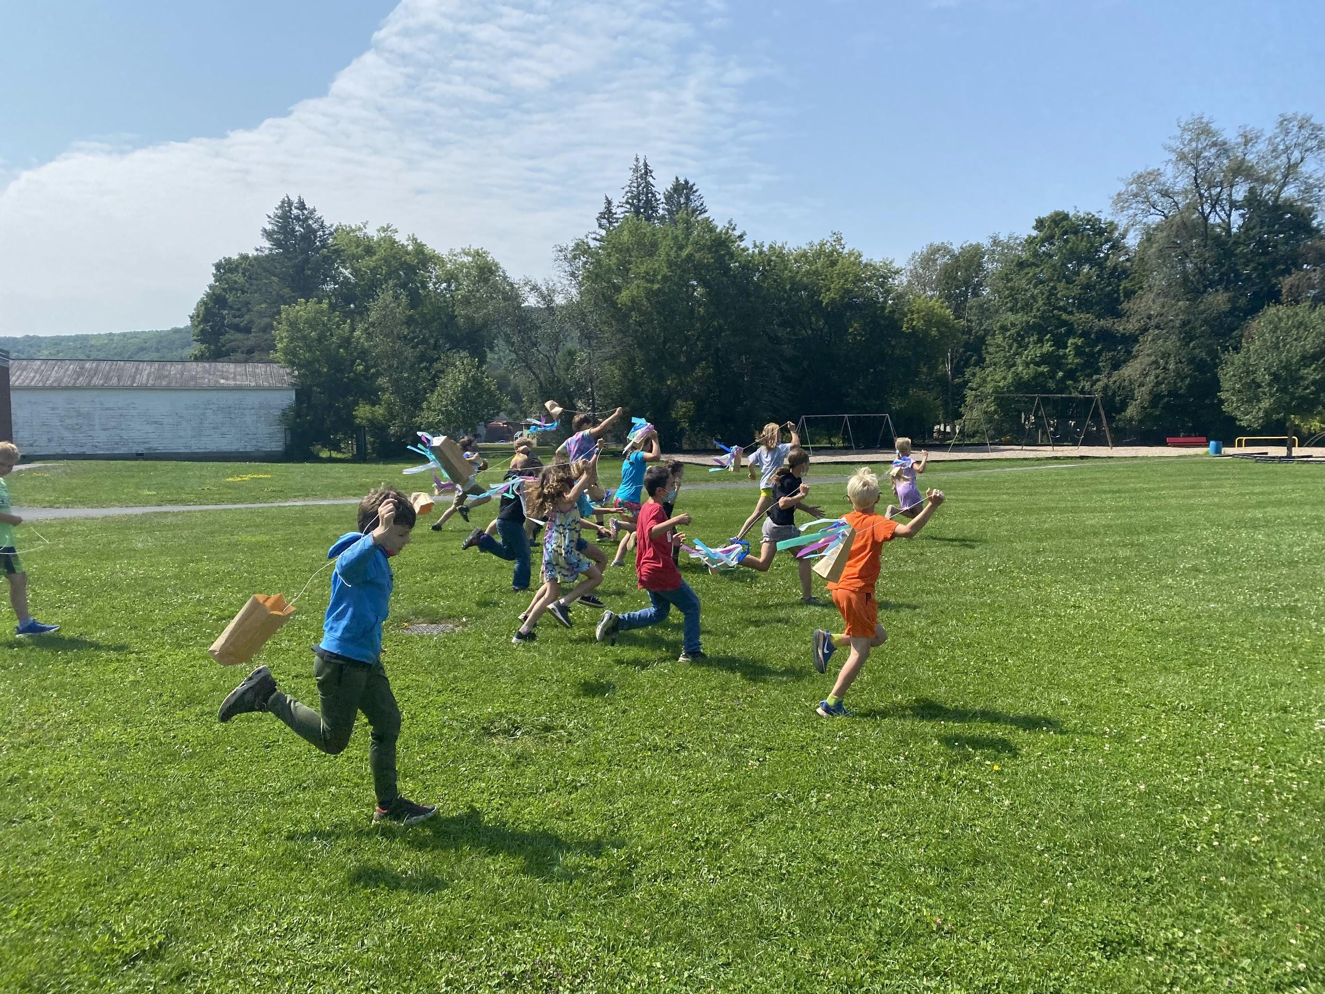
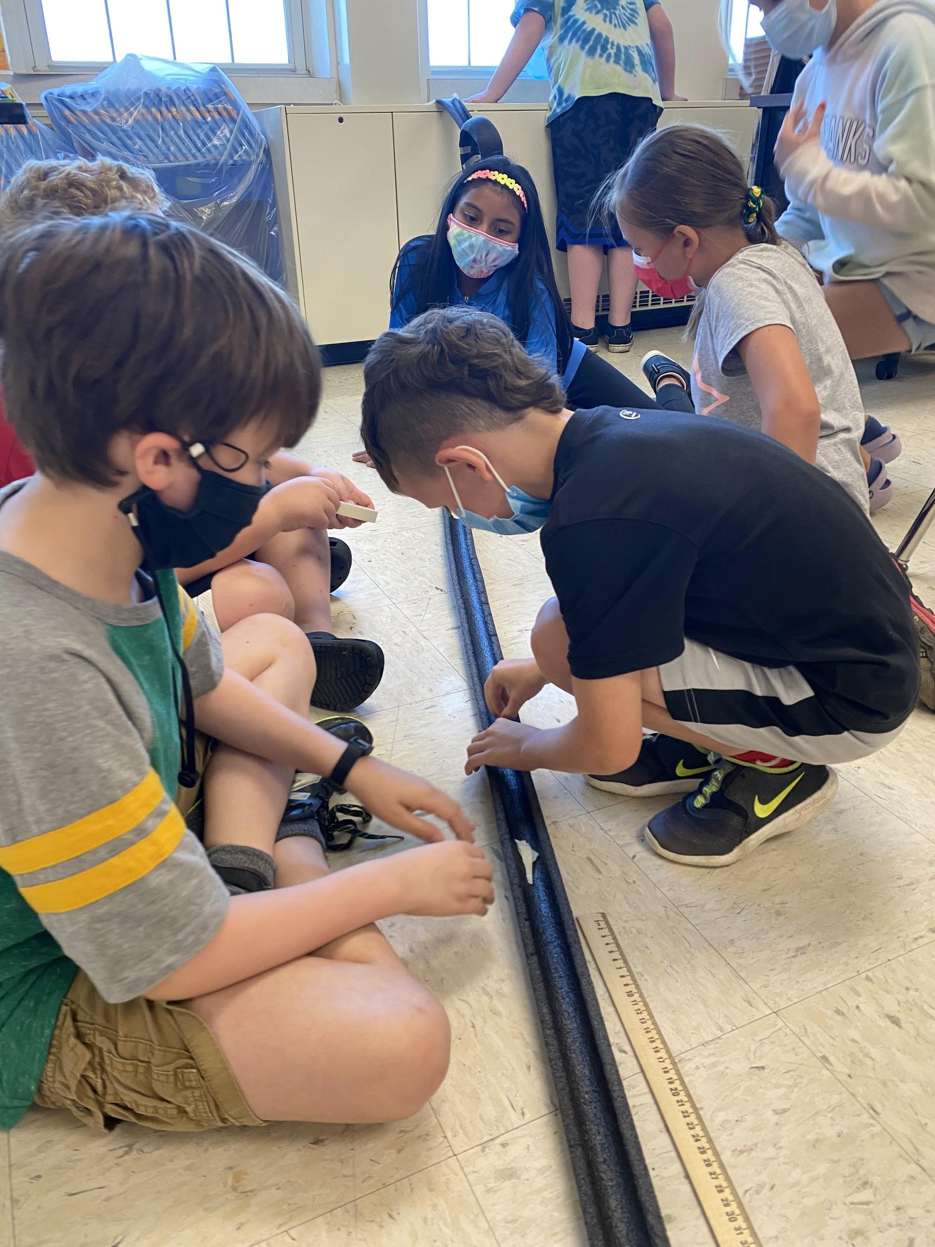
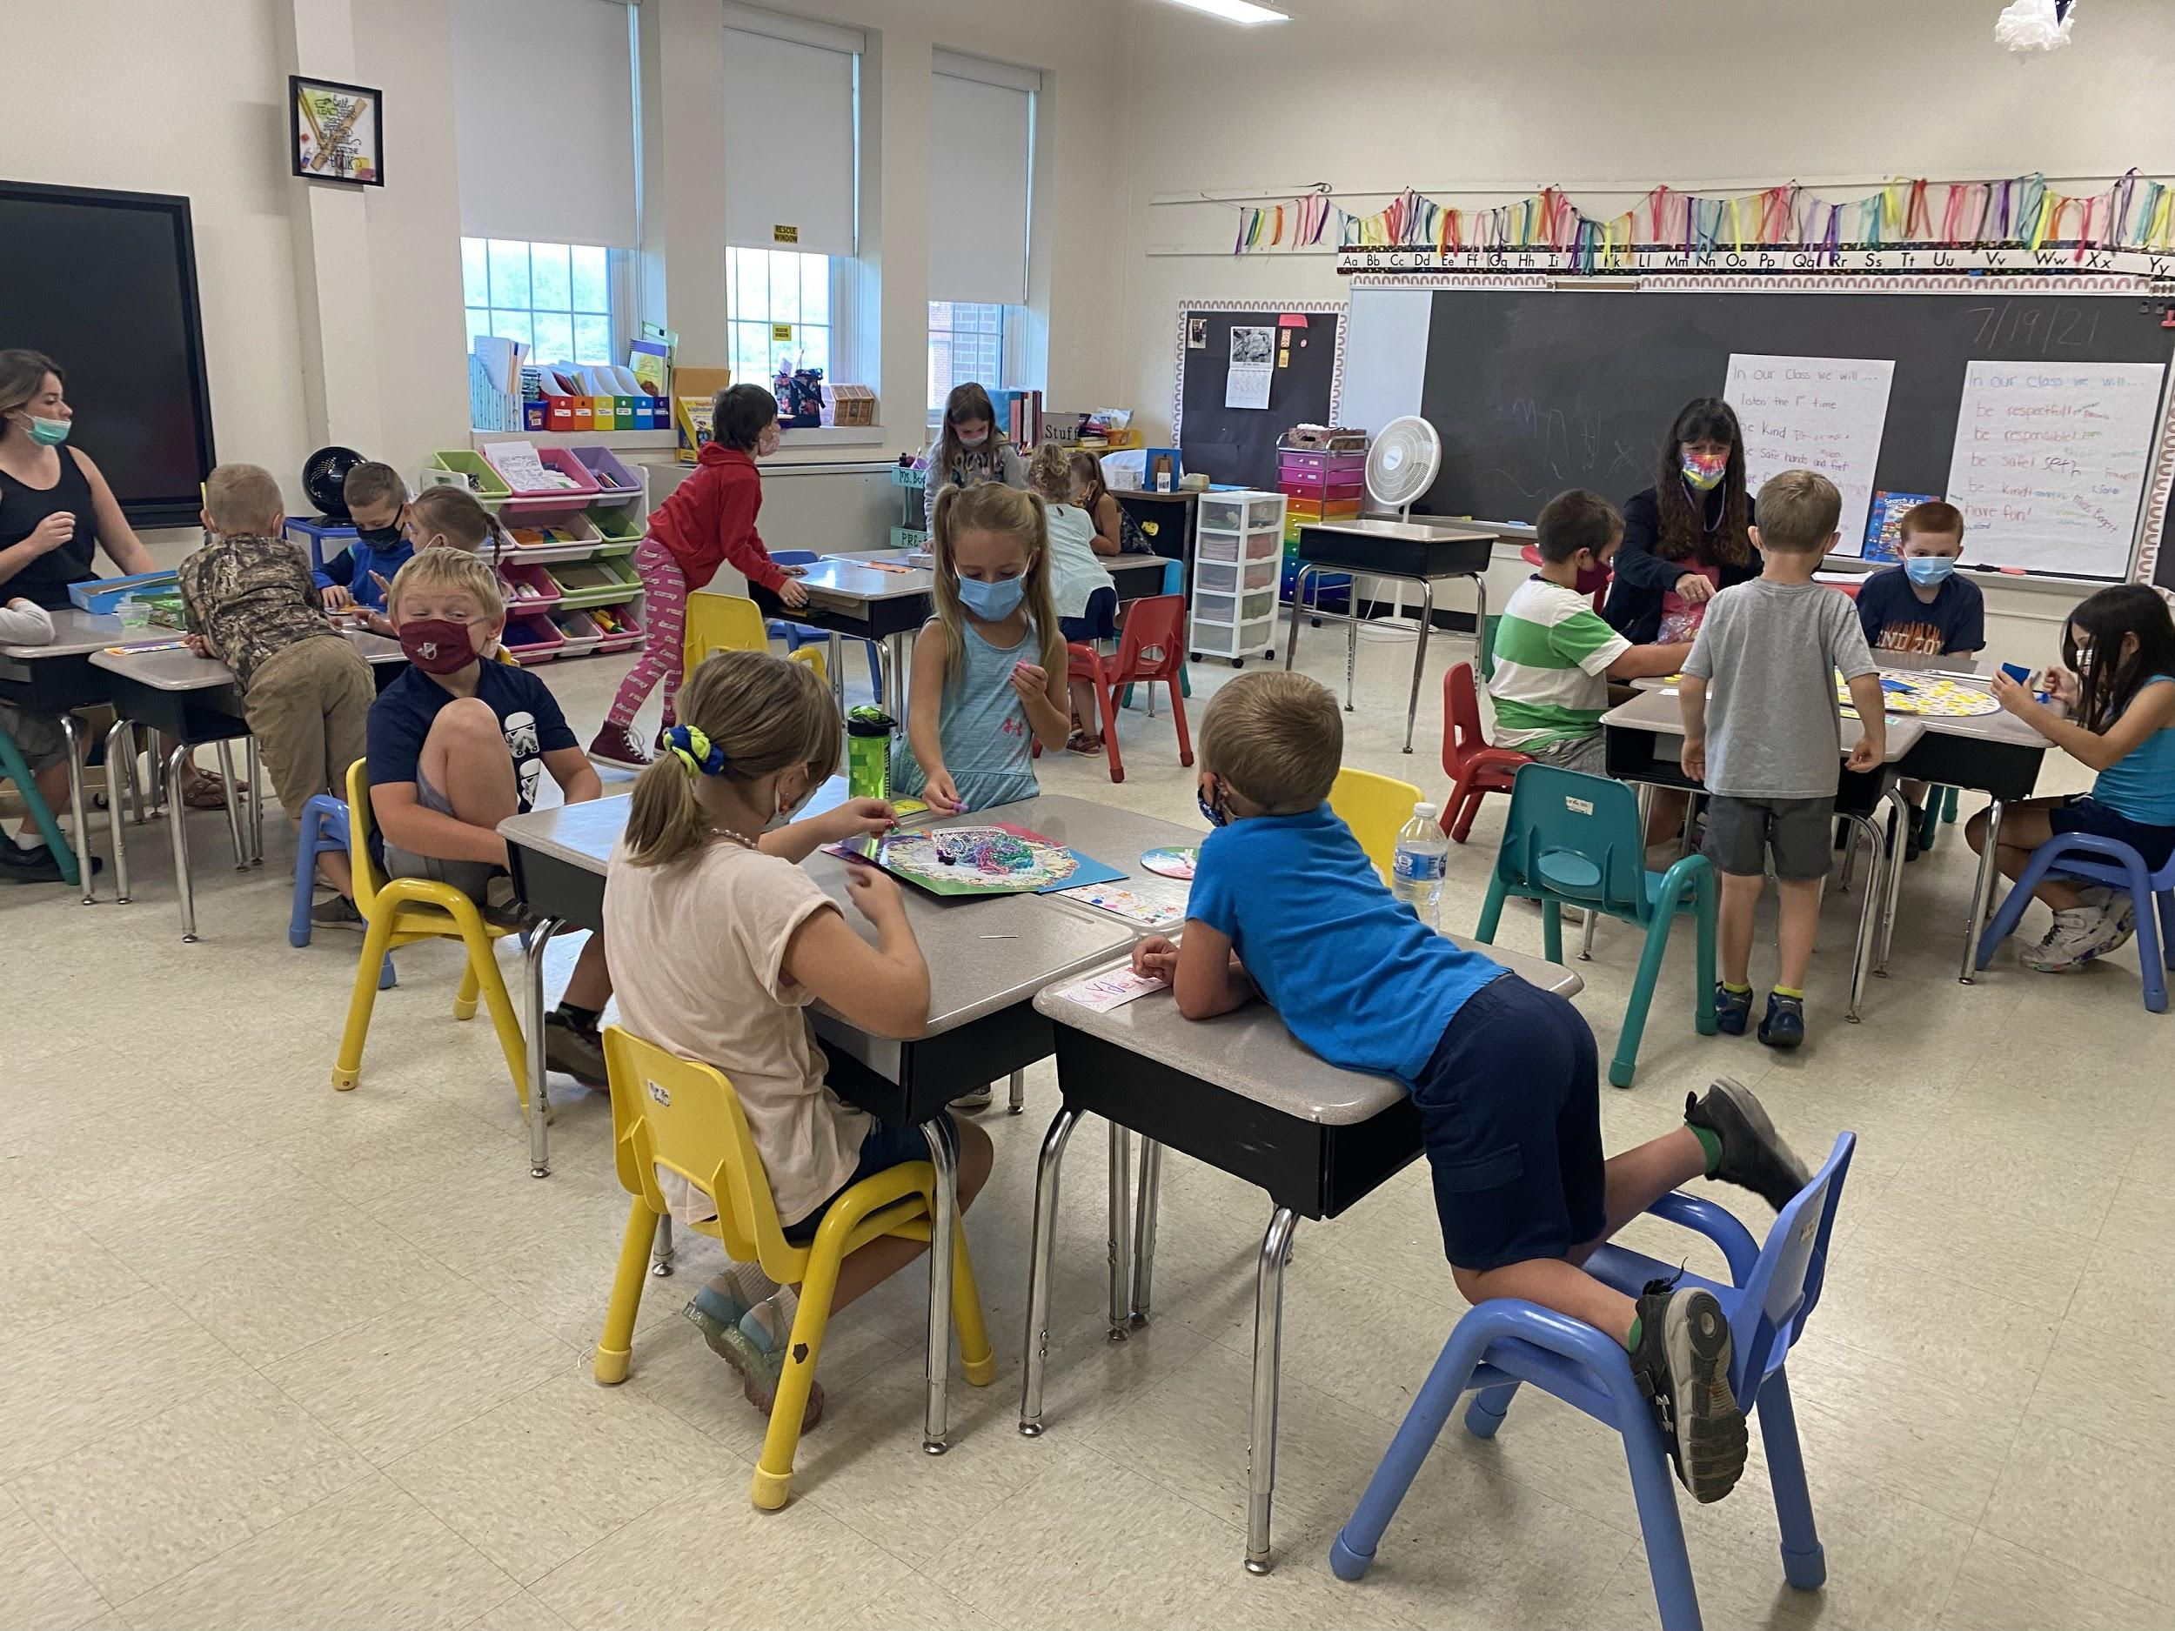
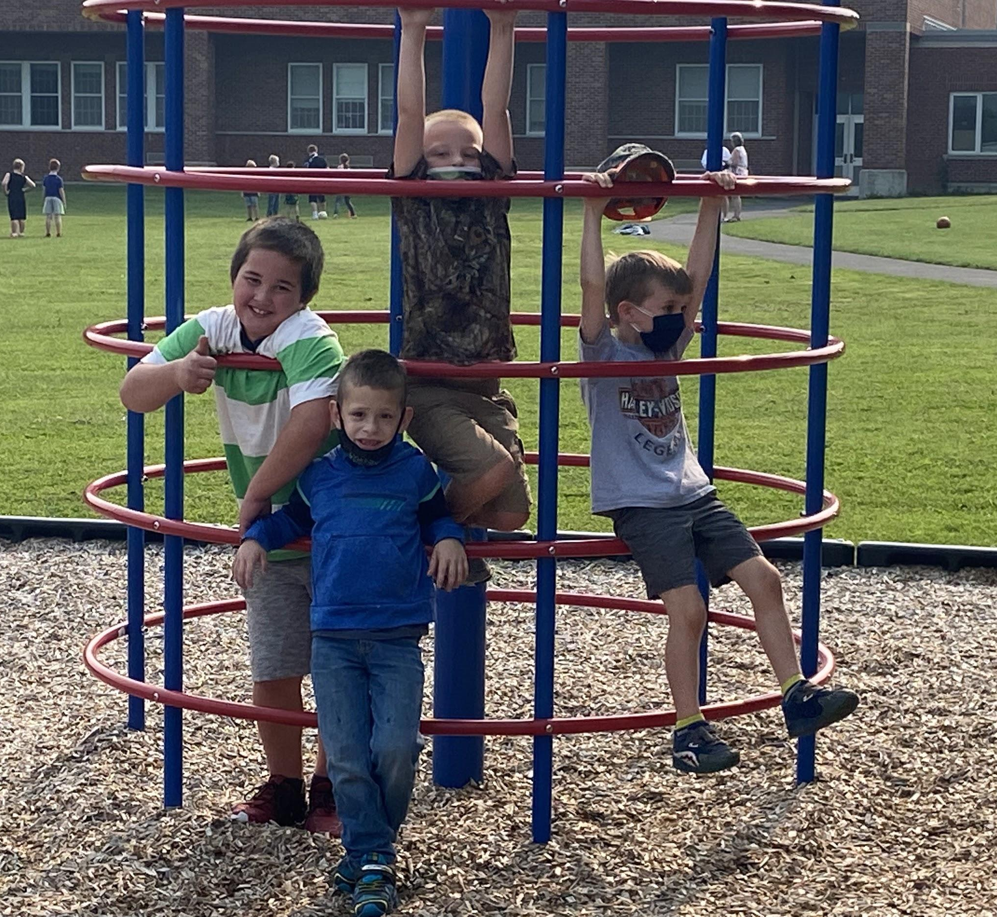
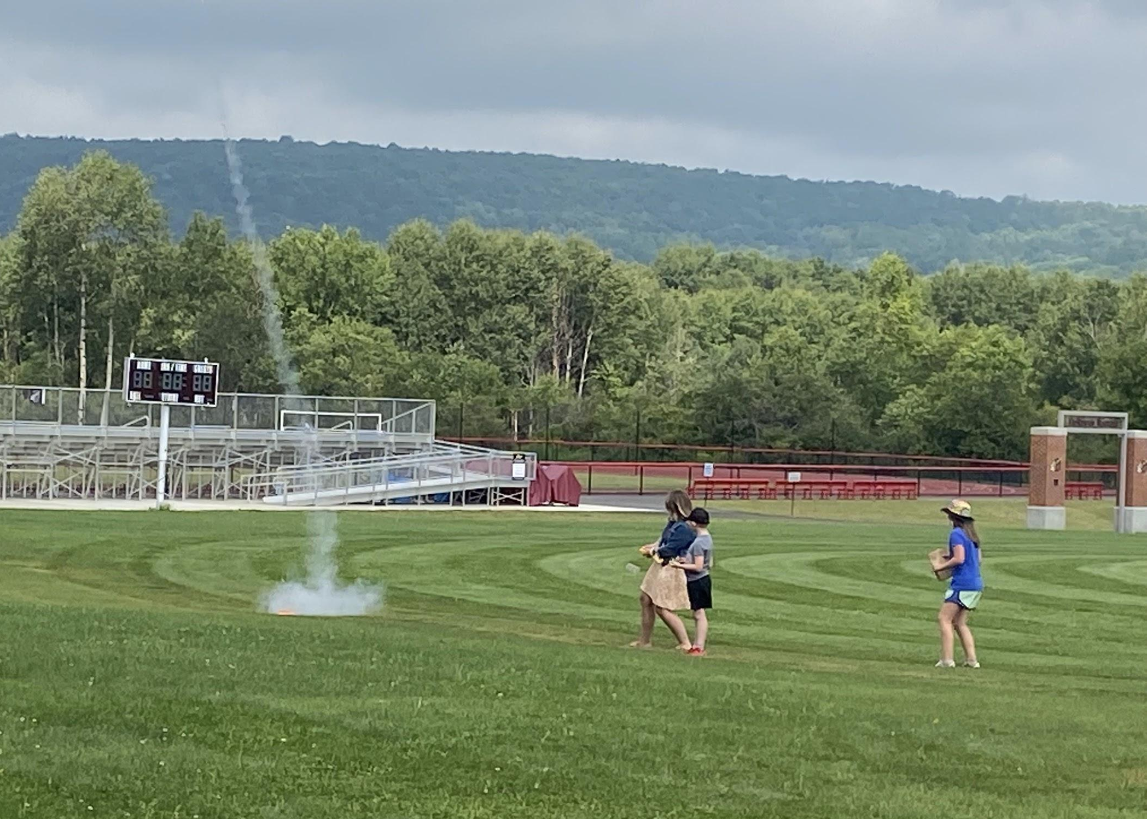
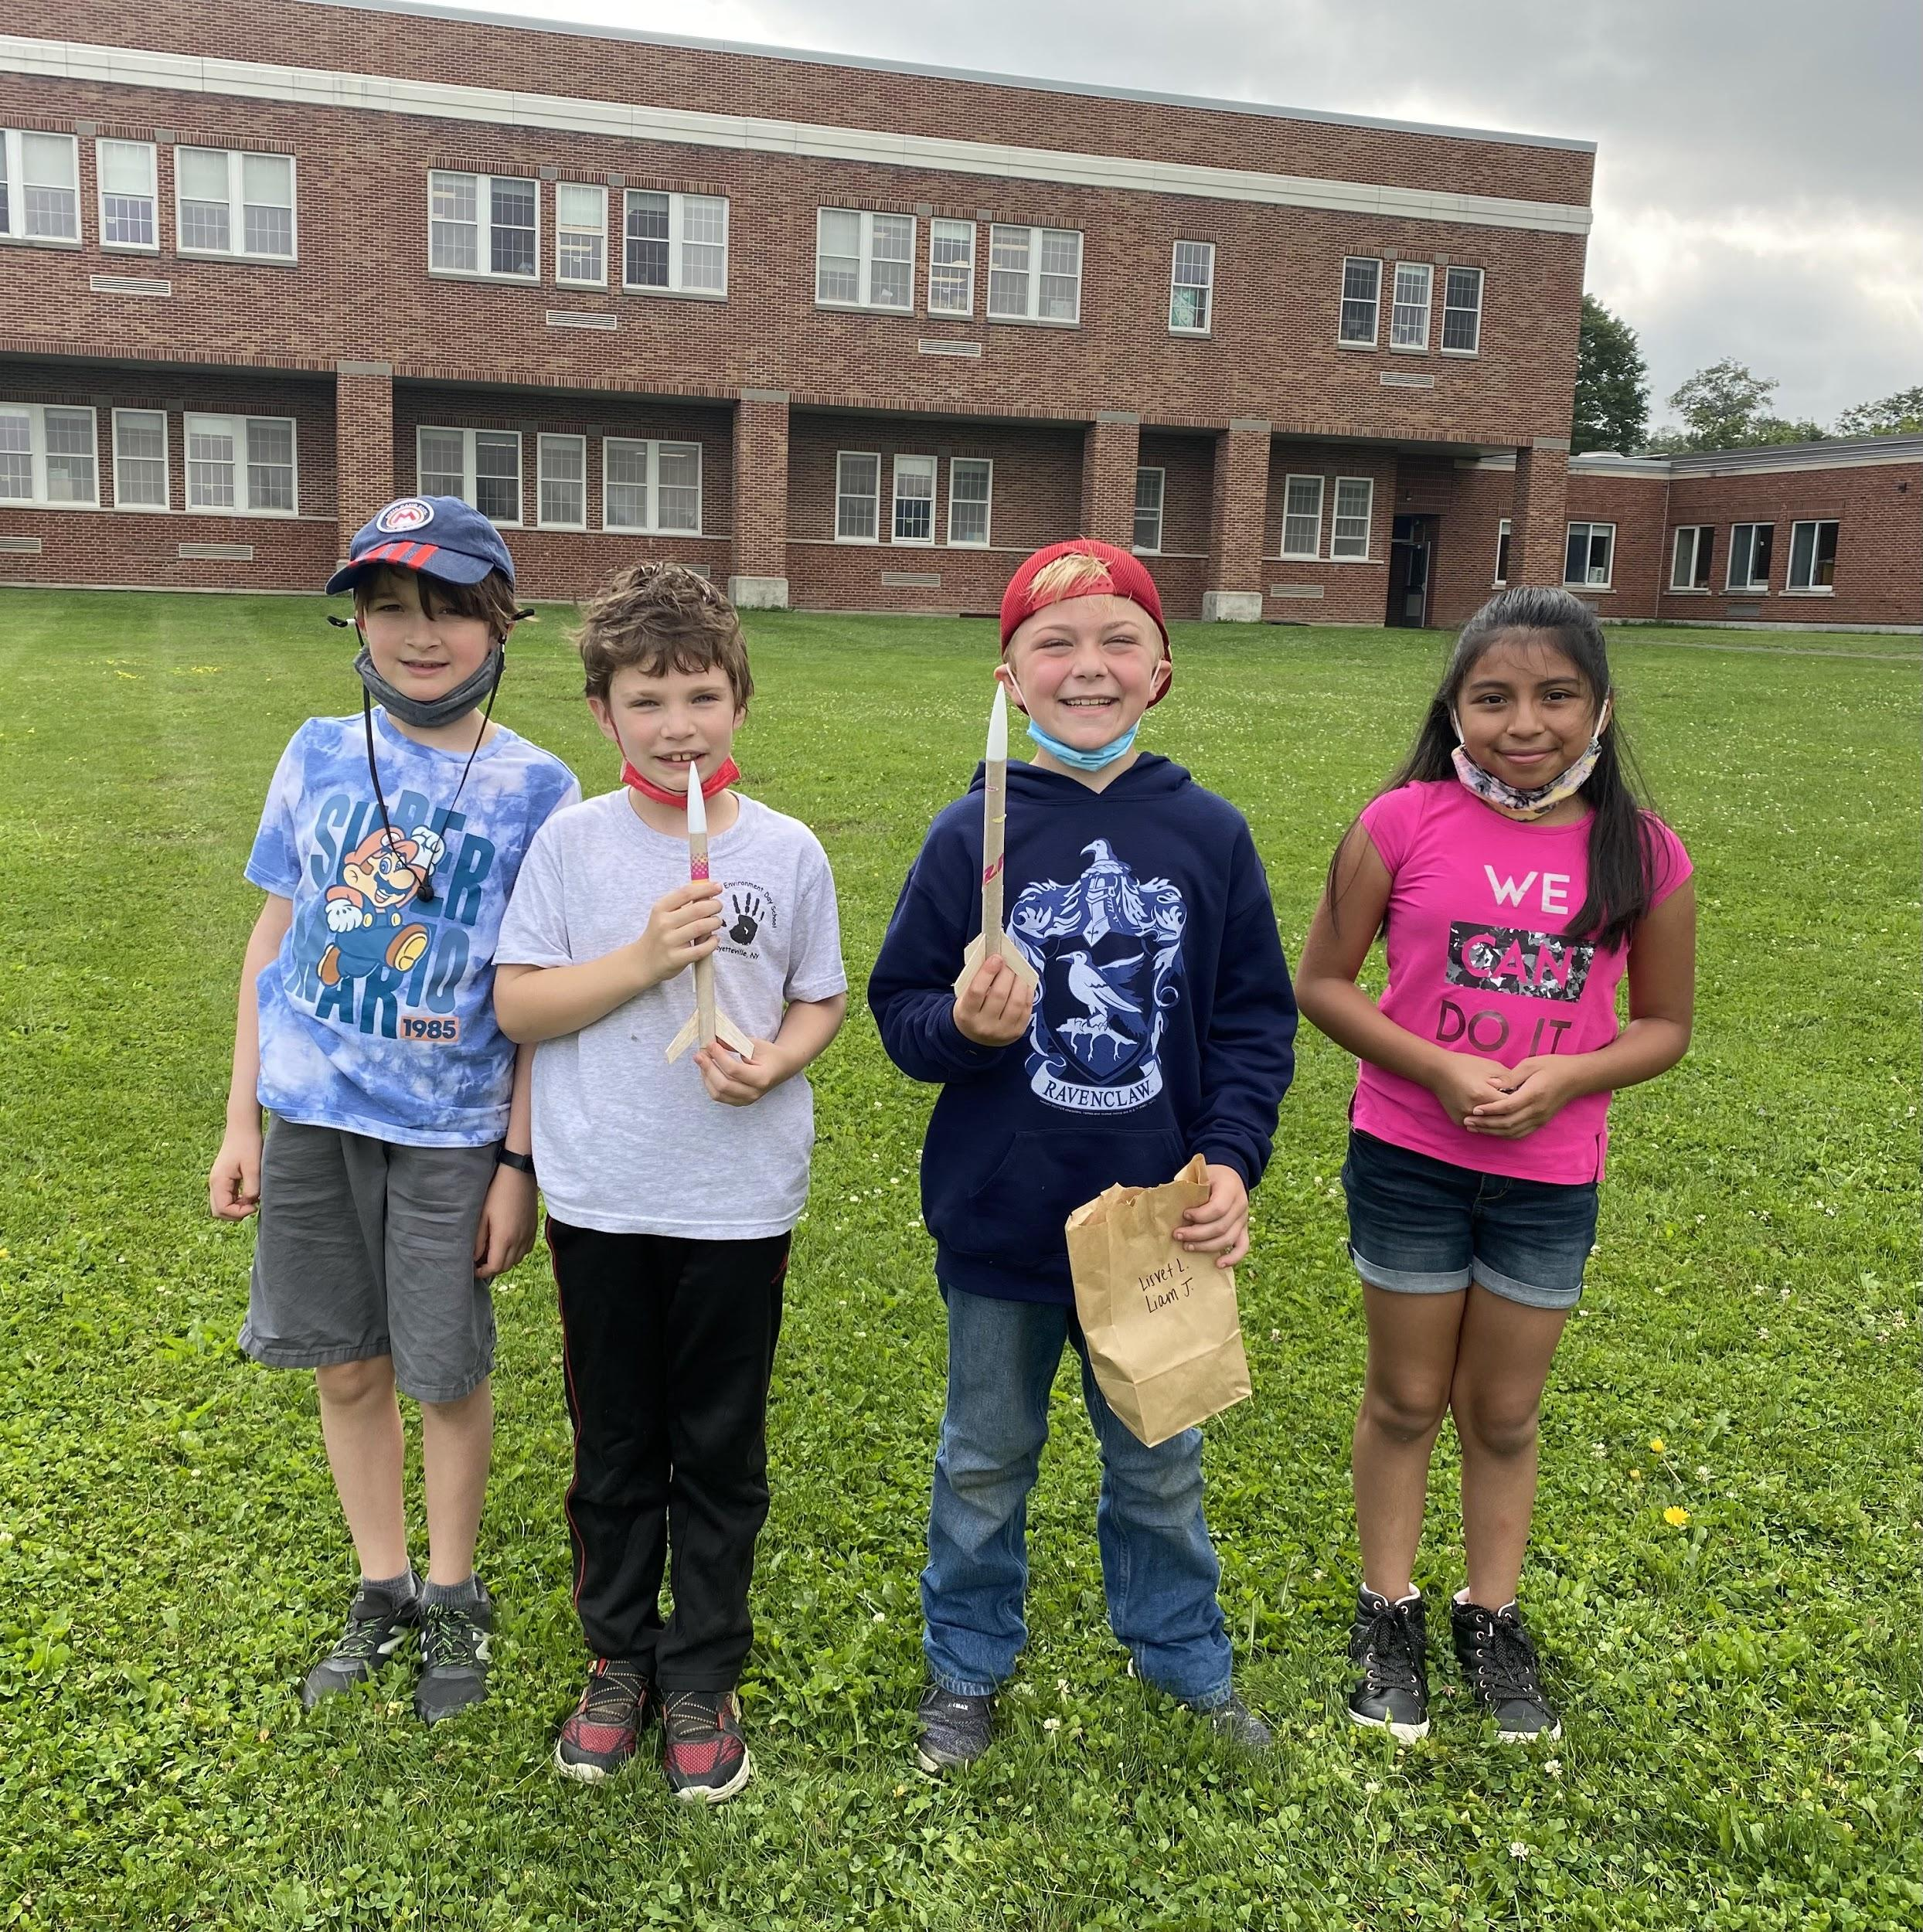
Mission Possible, Summer 2021

Slide 2
2022 Summer Program Planning
Welcome to Rocket Land!

Slide 3
Program Overview
Students entering grades K-6
Monday- Thursday; 8- 11:30 (Staff hours 7:30- 12)
July 5th-August 11th
3 two week sessions
July 5th- July 14th
July 18th- July 28th
August 1st- August 11th
Students can attend 1, 2 or 3 two week sessions
Staff can apply to work any or all of the two week sessions
3-4 multi-age classes, 15 student cap per class

Slide 4
Program Components
1 hour reading/math foundational skills practice
1 hour outdoor time and snack (family style with read aloud, would like to bring in guest readers)
Approximately 90 minutes for enrichment-based activities
Enrichment planning should incorporate flexible thinking, problem solving, art/music/theater, SEL, coding (per parent and student surveys); cooking was also a popular student response
Different enrichment programs will be offered every two week session.

Slide 5
Other Information
First come/first serve
Use rooms in MS wing (A/C)
Transportation is provided (to those eligible based on address)
Snack provided daily
Jess Vadala will work for part of each day.
LMC open for book exchange on Wednesday (8:30- 11:30)
Looking to involve local businesses

Slide 6
What’s Next?
Advertise (cafeteria- week of April 4th)
Enroll students (open on April 8th, info to go home with Q3 report card)
Hire staff
1 Teacher and 1 TA per class
Budget will be provided for materials/supplies

Slide 7
Summer Planning Team: Sam Bogert, Amanda Graham-Quirk, Lisa Hirt, Jen Jones, Molly LaHart and Kevin Springer
Sm Bogert

